Slide 1

ACM CCS 2017 Paper Awards

Slide 2
The Selection Process
Three-Step Process
Step I: PC nomination (two weeks)
22 papers nominated (out of 151 accepted)
Step II: BPAC vote (two weeks)
11 official finalists
Step III: BPAC review and ranking (two weeks)
Based on camera-ready version of finalists
Conflict-of-Interest handled same way as review process

Slide 3
The Selection Process
The Best Paper Award Committee (BPAC)
Chairs: The three PC co-chairs
Coordinator: Dongyan Xu
Members:
Scott Coull
Tudor Dumitras
Trent Jaeger
Taesoo Kim
Engin Kirda
Mohammad Mahmody

Slide 4
Congratulations Again to All Finalists!
This is a remarkable accomplishment!
1.3% of submitted papers
7.3% of accepted papers

Slide 5
Now for the awards! (by type, in order by paper number)

Slide 6
ACM CCS 2017 Real-World Impact Awards (2) To recognize papers with substantial immediate impact

Slide 7
CCS 2017 Real-World Impact Award
The Return of Coppersmith’s Attack: Practical Factorization of Widely Used RSA Moduli
Matus Nemec, Marek Sys, Petr Svenda,
Dusan Klinec, Vashek Matyas

Slide 8
CCS 2017 Real-World Impact Award
Key Reinstallation Attacks:
Forcing Nonce Reuse in WPA2
Mathy Vanhoef Frank Piessens

Slide 9
ACM CCS 2017 Best Paper Awards (5)

Slide 10
CCS 2017 Best Paper Award
Scaling ORAM for Secure Computation
Jack Doerner abhi shelat

Slide 11
CCS 2017 Best Paper Award
Better Bounds for Block Cipher Modes of Operation
via Nonce-Based Key Derivation
Shay Gueron Yehuda Lindell

Slide 12
CCS 2017 Best Paper Award
DolphinAttack:
Inaudible Voice Commands
Guoming Zhang, Chen Yan, Xiaoyu Ji, Tianchen Zhang, Taimin Zhang, Wenyuan Xu

Slide 13
CCS 2017 Best Paper Award
Authenticated Garbling and Efficient Maliciously Secure
Two-Party Computation
Xiao Wang, Samuel Ranellucci, Jonathan Katz

Slide 14
CCS 2017 Best Paper Award
A Formal Foundation for
Secure Remote Execution
of Enclaves
Pramod Subramanyan, Rohit Sinha, Ilia Lebedev, Srinivas Devadas, Sanjit Seshia

Slide 15
ACM CCS 2017 Test-of-Time Award

Slide 16
CCS Test-of-Time Award
Recognizes papers from CCS ten years prior that have had the greatest impact on security research and practice over the past decade.

Slide 17
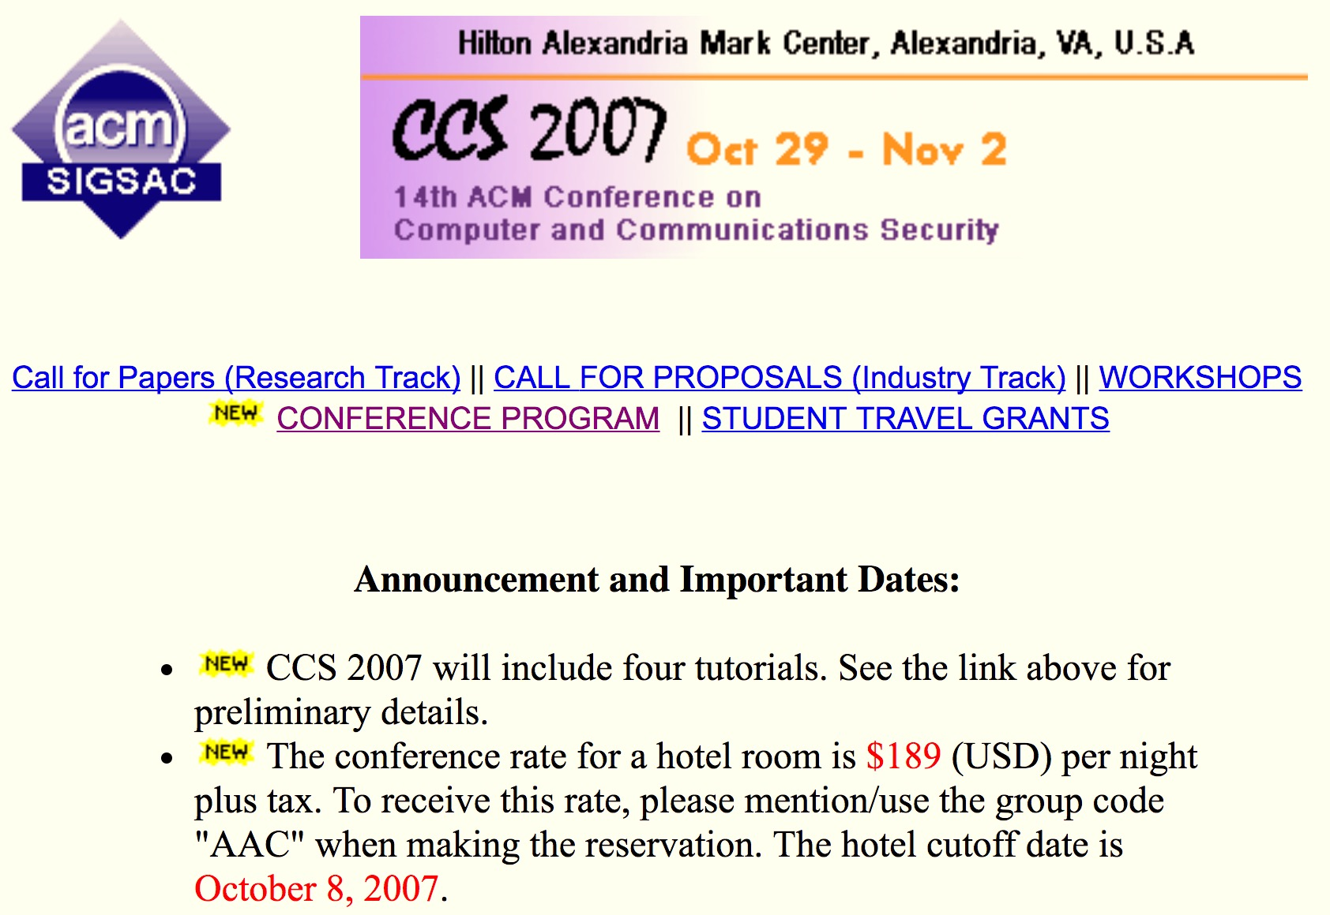
CCS 2007
55 papers (CCS 2017: 151)
hotel rate: $189 (CCS 2017: $199)
Over 14,000 citations (google scholar) to CCS 2007 papers

Slide 18
Test-of-Time Committee
David Evans (Chair) Véronique Cortier Jonathan Katz Tal Malkin Paul Syverson (CCS 2007 PC Co-Chair) Sabrina De Capitani di Vimercati (CCS 2007 PC Co-Chair)

Slide 19
Award Process
Five most highly-cited papers automatically considered, committee nominated one additional paper to consider
Extensive email discussions and multiple voting rounds to reach consensus

Slide 20
the winner is…

Slide 21
CCS 2017 Test-of-Time Award
The Geometry of Innocent Flesh on the Bone: Return-into-libc without Function Calls (on the x86)
Hovav Shacham

Slide 22
Session 2H: “Code Reuse Attacks”
9am tomorrow, Honorary Session Chair: Hovav Shacham
The Dynamics of Innocent Flesh on the Bone: Code Reuse Ten Years Later
Capturing Malware Propagations with Code Injections and Code-Reuse attacks
Code-reuse attacks for the Web: Breaking Cross-Site Scripting Mitigations via Script Gadgets

Slide 23

2017 ACM SIGSAC Awards

Slide 24
SIGSAC Awards
SIGSAC Doctoral Dissertation Awards
SIGSAC Outstanding Innovation Award
SIGSAC Outstanding Contributions Award

Slide 25
SIGSAC Doctoral Dissertation Award
For Outstanding PhD Thesis in Computer and Information Security
This annual award by SIGSAC will recognize excellent research by doctoral candidates in the field of computer and information security.

Slide 26
Considering Nominating in 2018
Check out https://www.sigsac.org/award/diss-awards.html
Or search for “SIGSAC Dissertation Award”
Nominations for the award must include: A statement summarizing the candidate's PhD thesis contributions and potential impact, and justification of the nomination);
PhD thesis; and
Three endorsement letters supporting the nomination.

Slide 27
2017 SIGSAC Doctoral Dissertation Award Committee
Gilles Barthe
Farinaz Koushanfar
Cristina Nita-Rotaru
Ahmad-Reza Sadeghi (Chair)
Mathew Smith

Slide 28
SIGSAC Doctoral Dissertation Award Runner-up
Adam Bates
“Designing and Leveraging Trustworthy Provenance-Aware Architectures”

Slide 29
SIGSAC Doctoral Dissertation Award
Brendan Saltaformaggio
“Convicted by Memory: Automatically Recovering Spatial-Temporal Evidence from Memory Images”

Slide 30
2017 SIGSAC Awards Committee
Michael Reiter (chair)
Michael Backes Elisa Bertino
Haibo Chen Sonia Chiasson
Robert Deng Úlfar Erlingsson
Alina Oprea Giovanni Vigna

Slide 31
Considering Nominating in 2018
Check out https://www.sigsac.org/award/sigsac-awards.html
Or search for “SIGSAC Awards”
Nominations should include a proposed citation (up to 25 words), a succinct (100-250 words) description of the innovation/contribution, and a statement (1-2 page) to justify the nomination.
Each nomination should be co-sponsored by at least 3 people. Email co-sponsorship is accepted.

Slide 32
SIGSAC Outstanding Innovation Award
This award is given for outstanding and innovative technical contributions to the field of computer and communication security that have had lasting impact in furthering or understanding the theory or development of secure systems.

Slide 33
2017 SIGSAC Outstanding Innovation Award
Shai Halevi
For outstanding innovations in theoretical and applied cryptography, bringing cutting-edge cryptographic capabilities closer to practice

Slide 34
SIGSAC Outstanding Contributions Award
This award is given for significant contribution to the field of computer and communication security through fostering research and development activities, educating students, or providing professional services such as the running of professional societies and conferences.

Slide 35
2017 SIGSAC Outstanding Contributions Award
Gene Tsudik
For leadership in security and privacy research
Notes:
Served as CCS Program Chair in for 5th CCS, and general Chair for 8th CCS in 2001. Served as EiC for ACM TISSEC from 2009 to 2016.

Slide 36
ACM CCS 2017 Banquet Closing

Slide 37


Cyber Security Research and Education at The University of Texas at Dallas http://csi.utdallas.edu November 2017
FEARLESS engineering

Slide 38
Our Faculty
Founder
Bhavani Thuraisingham, PhD, DEng (U of Wales, U of Bristol - UK)
Faculty from the School of Engineering and Computer Science
Alvaro Cardenas, PhD (U of MD) Cyber Physical Systems Security
Jorge Cobb, PhD (UTAustin) Cyber Security Outreach, Reliable Networks
Yvo Desmedt, PhD (U. Leuven-Belgium) Cryptography
Zygmunt Haas, PhD (Stanford) Wireless Network Security
Kevin Hamlen, PhD (Cornell) Language and Software Security
Shuang Hao, PhD (GATech) Network Security and DNS Attacks
Murat Kantarcioglu, PhD (Purdue) Data Security and Privacy
Latifur Khan, PhD (U of Southern CA) Big Data Analytics for Security
Zhiqiang Lin, PhD (Purdue) Systems Security and Forensics
Yiorgos Makris, PhD (UC San Diego) Hardware Security
Kamil Sarac, PhD (UC Santa Barbara) Cyber Security/Cyber Operations Education, Network Measurements
Janelle Straach, PhD (UT Dallas) Women in Cyber Security
Several affiliated faculty from multiple schools at UTD (Sample)
Michael Baron, PhD (U of MD) Statistical Methods for Security (currently at American University)
Alain Bensoussan, PhD (University of Paris) Risk Analysis for Security
Nathan Berg, PhD (U of Kansas) Economics and Security (currently in New Zealand)
Jennifer Holmes, PhD (U of MN) Cyber Security Policy
Patrick Brandt, PhD (Ohio State) Political Science
Daniel Krawczyk, PhD (UCLA) Psychosocial Aspects of Security
J.V. Rajendran, PhD (NYU) Hardware Security (Adjunct; currently at Texas A&M)

Slide 39
Research Thrusts
Active Malware Defense / Cyber Deception
Data Security and Privacy
Secure Cloud Computing
Cyber Physical Systems/IoT Security
Hardware Security
Data Analytics/ML for Cyber Security
Network Security/Cryptography

Slide 40
Cyber Security Education
Variety of degrees and certificates in Cyber Security as well as in Cyber Operations
NSF Scholarship for Service
Conferences and Workshops to motivate and promote Women in Cyber Security, Data Science and Cloud Computing

Slide 41
We Are Hiring
Outstanding candidates in all areas of Cyber Security
Planning to announce a search for Executive Director after Fall 2018
Very Supportive Administration

Slide 42
Contact
Ms. Rhonda Walls, Project Coordinator rhonda.walls@utdallas.edu, (972) 883-2731
Dr. Bhavani Thuraisingham, Founding Executive Director bhavani.thuraisingham@utdallas.edu, (972) 883-4738
Follow us @CyberUTD

Slide 43
Congratulations!

